Slide 1

Yashwanth Mannava
Srilakshmiharimitha Madikuntala
NavyaSree Madagoni
Prasanna Manthena

Slide 2
Why do we care?
As of June 2024, approximately 1 million deaths have been reported due to COVID-19 in the U.S. (source: CDC).
Over 50% of hospitalized COVID-19 patients are aged 65 and older.
Patients with comorbidities such as cardiovascular diseases, diabetes, and respiratory conditions are at higher risk of hospitalization.
The estimated economic cost of COVID-19 in the U.S. exceeds $16 trillion, including healthcare costs and economic disruption (source: JAMA Network).

Slide 3
How can the analysis help?
Use
Use machine learning models to predict high-risk patients based on their health data and demographics.
Enable
Enable proactive healthcare measures and personalized care plans.
Implement
Early Intervention: Implement early warning systems to flag high-risk patients as soon as they test positive for COVID-19.

Slide 4

Our Problem Statement
To predict the high risk covid patients bases on PATIENT DATA

Slide 5
Dataset(1/2)
The unprocessed dataset contains 11,580 rows and 88 columns
since we are predicting the patient risk to covid at the time of admission, we filtered out post-admission features
Below are the features we removed:
'dischargedate', 'dischargedisposition', 'enc_cvd_lab_recs’, ,'pat_cvd_lab_recs', 'enc_dx_recs', 'enc_result_recs', 'enc_med_recs', 'enc_px_recs'

Slide 6
Dataset(2/2)
We also removed LoS because ”Length of Stay” is not available during the admission time.
We also removed ‘id’ columns from the dataset, as they do not add any value.
We also removed the ‘date’ columns from the dataset.

Slide 7
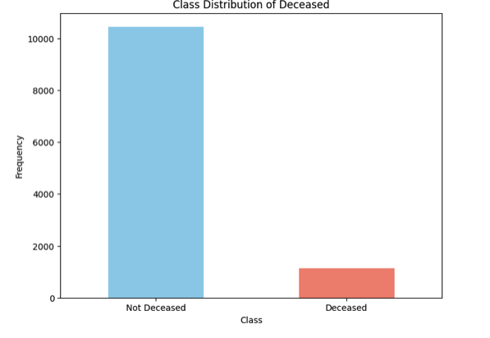
EDA-Target Variable
The positive class is very imbalanced
There are 90% of Zeroes and 10% of ones.
This will create a biased model towards the majority class.

Slide 8
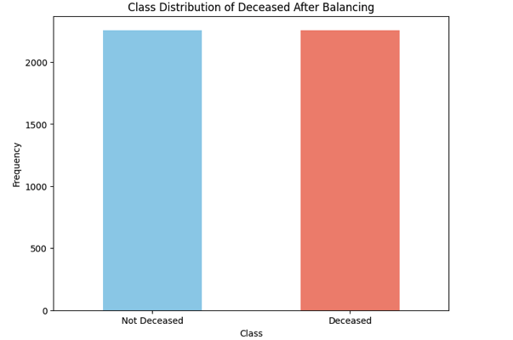
Balancing Target Variable
We balanced the target variable using a combination of both under sampling of majority class and oversampling the minority class so as to balance the target variable.
We used packages Randomundersampler and SMOTE to handle this problem.

Slide 9
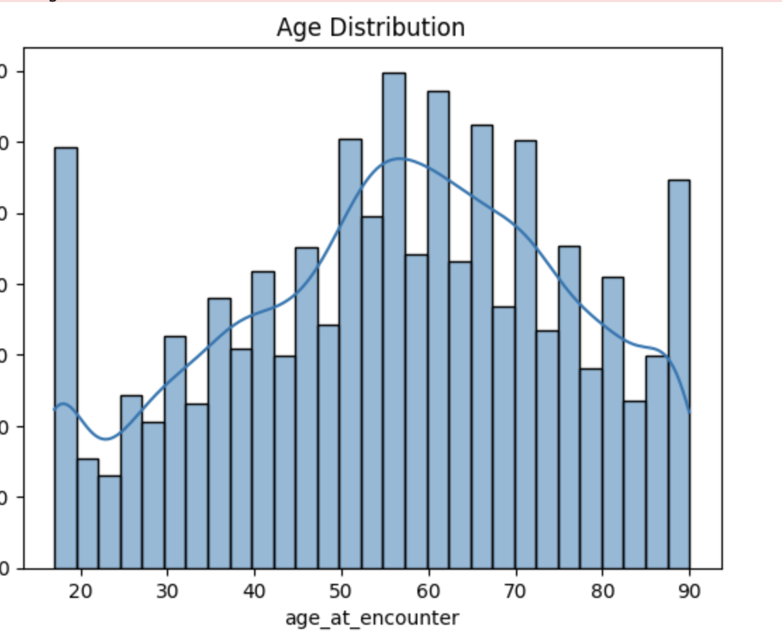
EDA-Age
1. The histogram shows a bell-shaped age distribution, peaking around 50-60 years, indicating this is the most common age range in the dataset.
2. The occurrence of encounters decreases for ages below 30 and above 80, with the overlaid KDE following the histogram's shape, confirming the normal distribution trend.

Slide 10
Feature Selection
There are 14 “Diagnosis” numerical columns in the dataset.
We only selected Diagnosis 1-5, and omitted the rest of the diagnosis columns as they do not add any value in the feature importance.

Slide 11
Data Pre-Processing
We have removed columns that have more than 70% missing values
For the rest of the columns, we did a MCAR test to find out if the missing values are completely at Random.
The MCAR rejected the null-hypothesis, resulting in random missing values.
After the MCAR test, we chose KNN imputation to replace missing values by averaging the k-nearest neighbors of the data points. (k=5)

Slide 12

Target Variable
Definition: The target variable 'deceased' is a binary variable indicating the survival status of a patient.
1: Represents that the patient is deceased.
0: Represents that the patient is not deceased (survived).

Slide 13
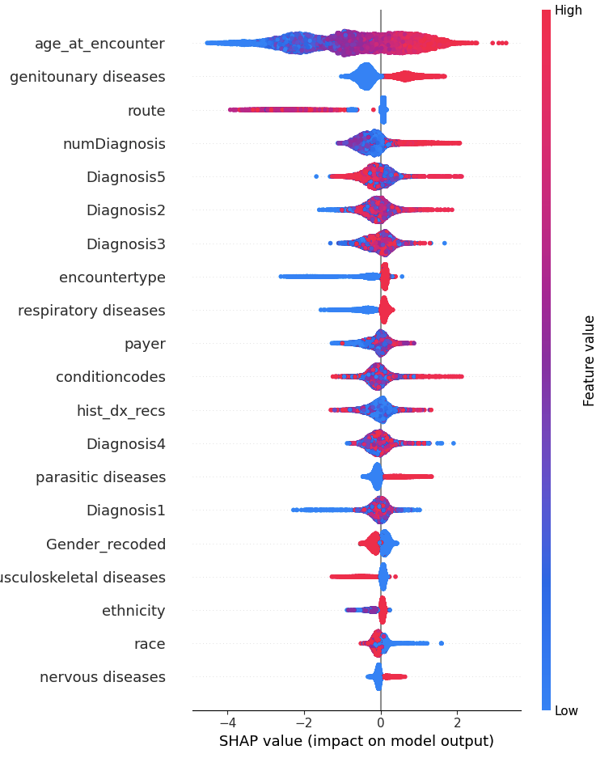
SHAP Analysis
We used BORUTASHAP to check the feature importances
This SHAP summary plot shows. Features like 'age_at_encounter' and 'genitourinary diseases' have significant influences, with high feature values increasing the model's prediction.

Slide 14
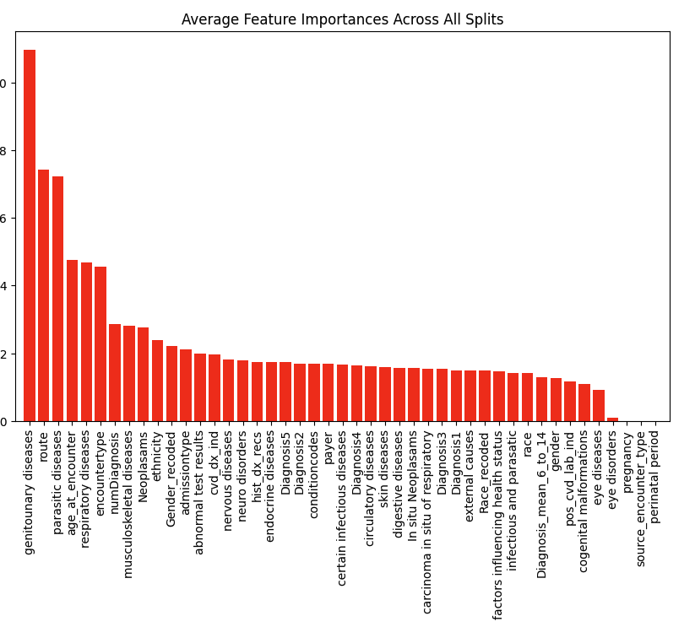
Feature Importances(1/
Since, our target variable is imbalanced, we used stratified sampling to split the data into 5 ensuring each split has the same proportion of the target class.
Here is the average feature importance across all splits.

Slide 15
Feature Importance (2/2)
We have included all the features which has average importance of more than 0.01, so as to include all important features.
This threshold importance is giving us the maximum accuracy in the final models.

Slide 16
Final Features (mean-imp >0.01)
Feature Name | Description
genitounary diseases | Diseases of the genitourinary system
route | Route of encounter
parasitic diseases | Diseases caused by parasites
age_at_encounter | Age of patient at the time of encounter
respiratory diseases | Diseases of the respiratory system
encountertype | Type of encounter (e.g., inpatient, outpatient)
numDiagnosis | Number of diagnoses
musculoskeletal diseases | Diseases of the musculoskeletal system
Neoplasams | Neoplasms (tumors)
ethnicity | Ethnicity of the patient
Gender_recoded | Gender of the patient (recoded)
admissiontype | Type of admission
abnormal test results | Presence of abnormal test results
cvd_dx_ind | Indicator for cardiovascular disease diagnosis
nervous diseases | Diseases of the nervous system
neuro disorders | Neurological disorders
hist_dx_recs | Historical diagnosis records
endocrine diseases | Diseases of the endocrine system
Diagnosis5 | Fifth diagnosis
Diagnosis2 | Second diagnosis
conditioncodes | Condition codes
payer | Payer information (insurance)
certain infectious diseases | Certain infectious diseases
Diagnosis4 | Fourth diagnosis
circulatory diseases | Diseases of the circulatory system
skin diseases | Diseases of the skin
digestive diseases | Diseases of the digestive system
In situ Neoplasams | In situ neoplasms (localized tumors)
carcinoma in situ of respiratory | Carcinoma in situ of the respiratory system
Diagnosis3 | Third diagnosis
deceased | Indicator if the patient is deceased
These are the final 31 features, with ‘deceased’ as the target column

Slide 17
One Hot Encoding
Before building our models, we have to convert the categorical columns to numerical columns.

Slide 18
Models
To predict out target variable with our final features, we have used five models
Logistic Regression
Random Forest
CatBoost
Xgboost
LightGBM

Slide 19
Cross-Validation
Cross-validation is used to ensure the model's performance is robust and generalizes well to unseen data by evaluating it on multiple train-test splits.
We have used k-fold cross validation by splitting the whole data into 5 splits i.e (k=5)

Slide 20
Evaluation Metrics
Since this is a binary classification problem the metrics we chose are:
ROC AUC score
F1 score
Precision
Recall
Accuracy

Slide 21
Results
 | accuracy | f1 | roc_auc | precision | recall
Logistic Regression | 0.81 | 0.82 | 0.81 | 0.77 | 0.88
Random Forest | 0.83 | 0.83 | 0.83 | 0.84 | 0.83
CatBoost | 0.86 | 0.86 | 0.86 | 0.84 | 0.88
XGBoost | 0.84 | 0.84 | 0.84 | 0.83 | 0.85
LightGBM | 0.84 | 0.84 | 0.84 | 0.84 | 0.85
Test Set Results

Slide 22
Conclusion
The best model is CatBoost due to:
High Accuracy: 0.86, indicating strong ability to distinguish classes.
Highest F1 Score: 0.86, balancing precision and recall effectively.
Balanced Precision and Recall: Precision 0.84, Recall 0.88, ensuring reliable identification of true positives.

Slide 23


